Slide 1
Real Estate Management System

Slide 2
Team members
Name | Role
Battuvshin Badarch | Team Leader
Aldarkhangai Chimed Ochir | Back-end Developer
Ferdinand Muriyesu | Back-end Developer
Dulamkhand Batjargal | Front-end Developer

Slide 3
Overview
The Real Estate Management system is a web based application which connect property sellers and buyers or renters. In this system there are three actors or users: Buyer, Seller and Manager or Agent.

Slide 4
Key features
Seller:
Register/login/logout
View, create, update, delete property
Give information
Sell, rent, buy delegate service

Slide 5
Key features(Con’t)
Buyer
Search
Register, login. Logout
Ask information
Buy, rent

Slide 6
Key features(Con’t)
Manager
Give information
Introduce property
Update property

Slide 7

Real Estate Management System, high level architectural design
Web browser
(Client Request)
DB/MySQL
Request
DAO
JDBC
Servlet Controller
HTTP
JSP
Model
Web Container
Response
Web server, Apache Tomcat

Slide 8
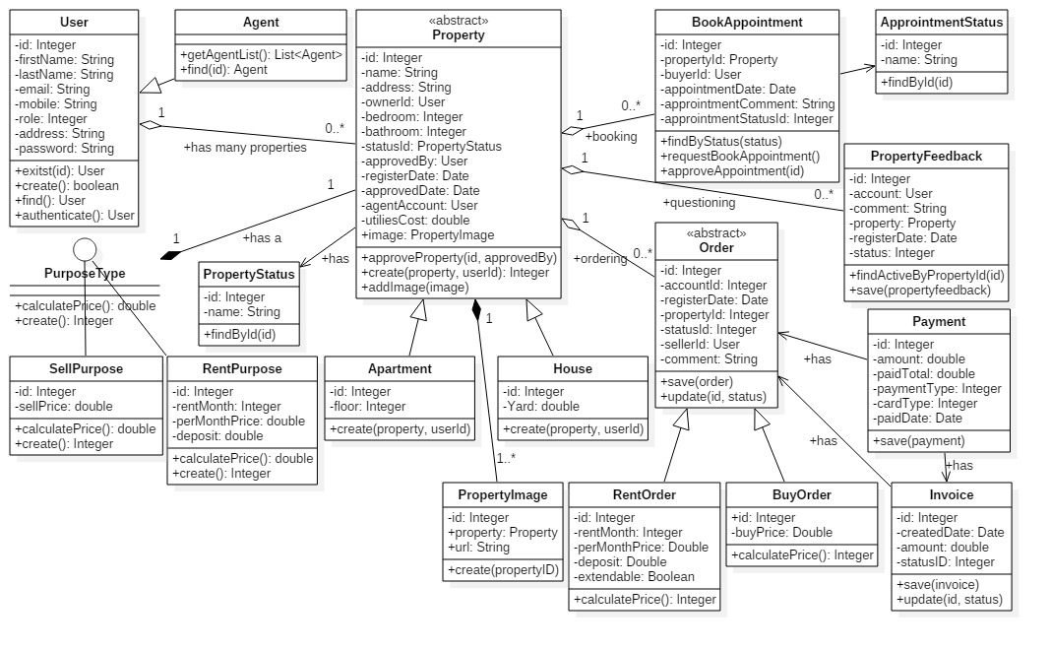
Business model & Associations

Slide 9
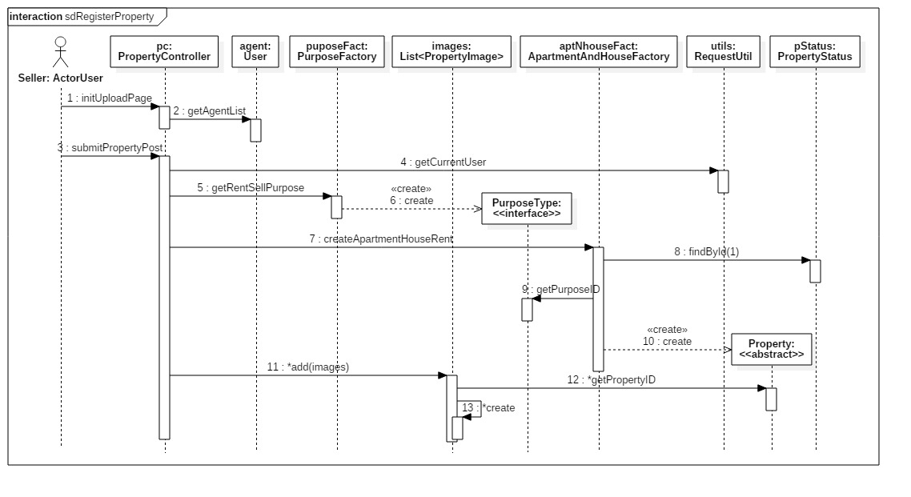
Example of sequence diagram/ Property registration

Slide 10
Tools used
IDE: Eclipse for backend and some frontend work,
Visual studio code for frontend
starUML for diagrams
Maven in Eclipse to ease the build process

Slide 11
Technology
The project is developed following MVC architecture approach,
Therefore the presentation is separated from the backend .
Java is the programming language used for backend development. Servlets were used as controllers, and the model is made of java classes.
JSP,HTML, JavaScript, jQuery were used on front end.
gitHub, git nd tortoisegit were used to share the work between members and truck the progress.
MySQL was used as database.

